Slide 1
Static Routing
Routing Protocols and Concepts – Chapter 2

Slide 2
Objectives
Define the general role a router plays in networks.
Describe the directly connected networks, different router interfaces.
Examine directly connected networks in the routing table and use the CDP protocol.
Describe static routes with exit interfaces.
Describe summary and default route.
Examine how packets get forwarded when using static routes.
Identify how to manage and troubleshoot static routes.

Slide 3
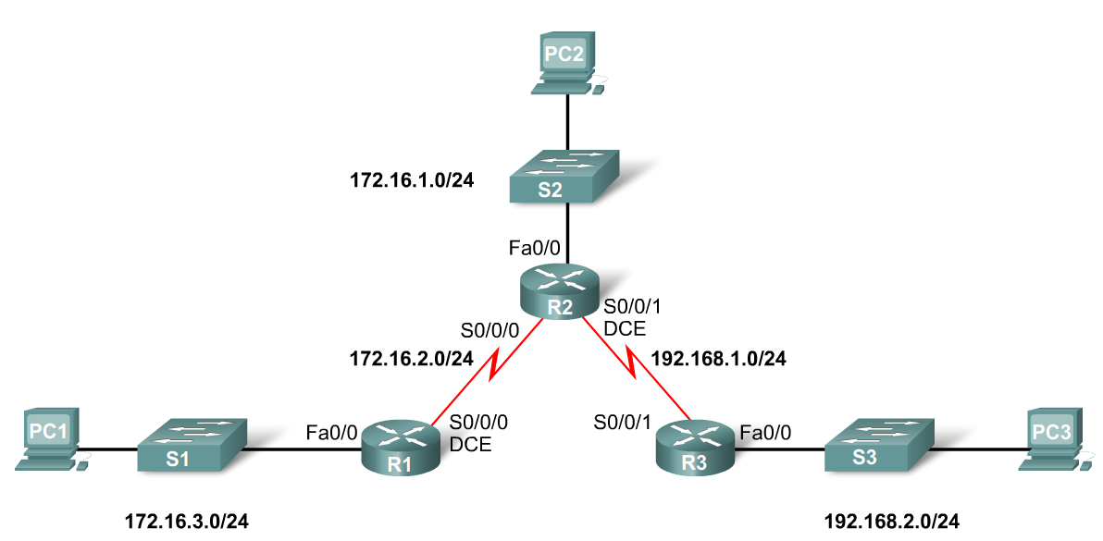
General Role of the Router
Functions of a Router
  Best Path Selections
  Forwarding packets to destination
Introducing the Topology
  3 1800 series routers connected via WAN links
  Each router connected to a LAN represented by a switch and a PC

Slide 4
General Role of the Router
Connections of a Router for WAN
  A router has a DB-60 port that can support 5 different cabling standards
Connections of a Router for Ethernet
  2 types of connectors can be used: Straight through and Cross-over
    Straight through used to connect:
      Switch-to-Router, Switch-to-PC, Router-to-Server, Hub-to-PC, Hub-to-Server
    Cross-over used to connect:
      Switch-to-Switch, PC-to-PC, Switch-to-Hub, Hub-to-Hub, Router-to-Router

Slide 5
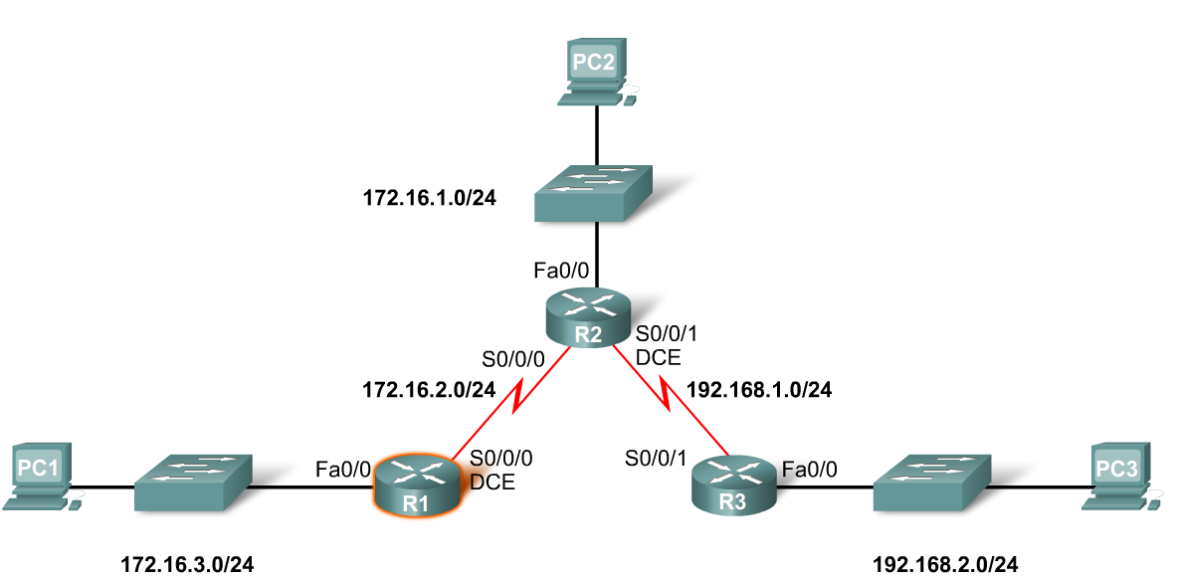
Interfaces
Examining Router Interfaces
  Show IP router command – used to view routing table
  Show Interfaces command – used to show status of an interface
  Show IP Interface brief command – used to show a portion of the interface information
  Show running-config command – used to show configuration file in RAM

Slide 6
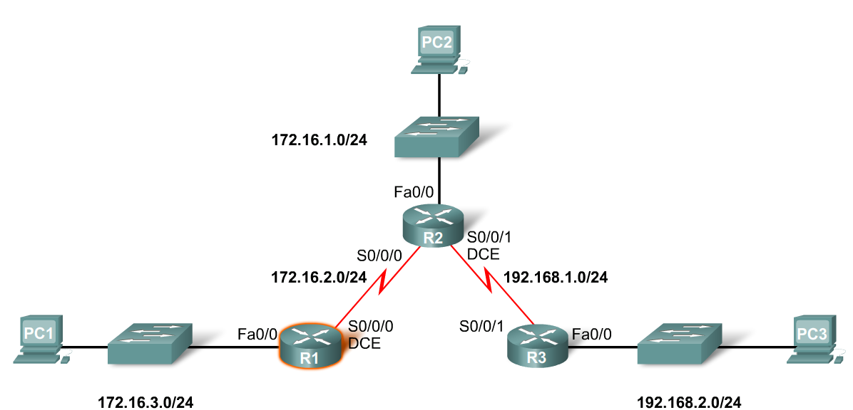
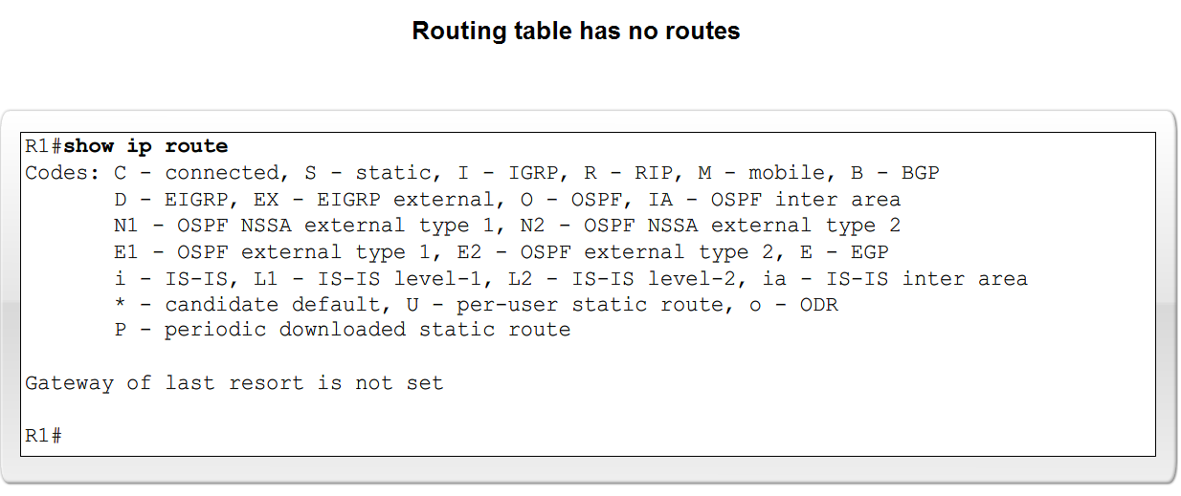
Interfaces
Configuring an Ethernet interface
  By default all serial and Ethernet interfaces are down
  To enable an interface use the No Shutdown command

Slide 7
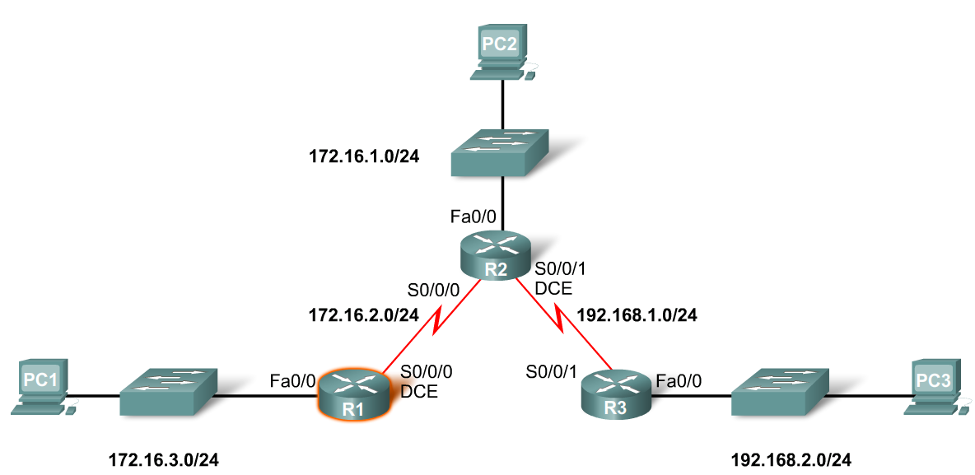
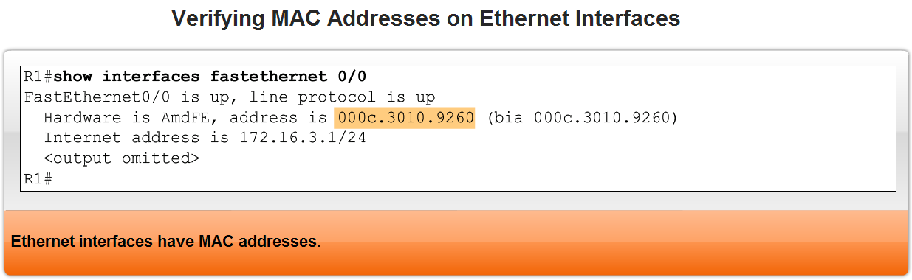
Interfaces
Verifying Ethernet interface
  Show interfaces for fastEthernet 0/0 – command used to show status of fast Ethernet port
  Show ip interface brief
  Show running-config
Ethernet interfaces participate in ARP

Slide 8
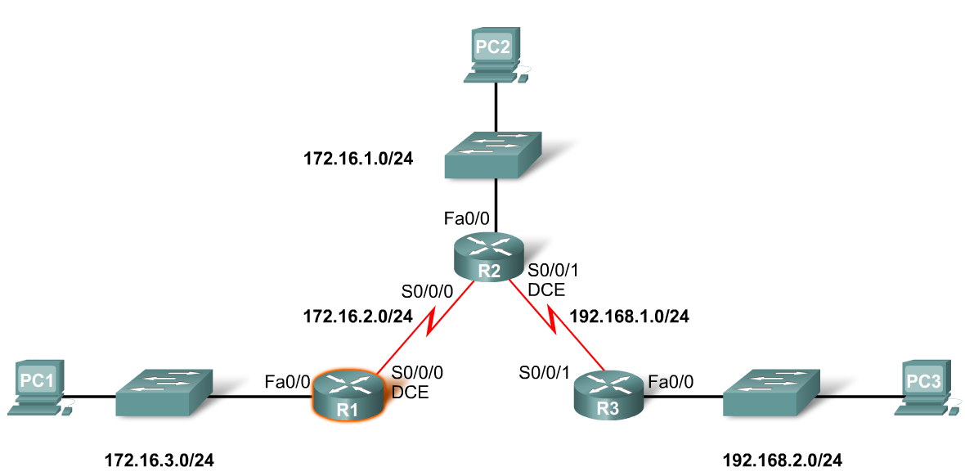
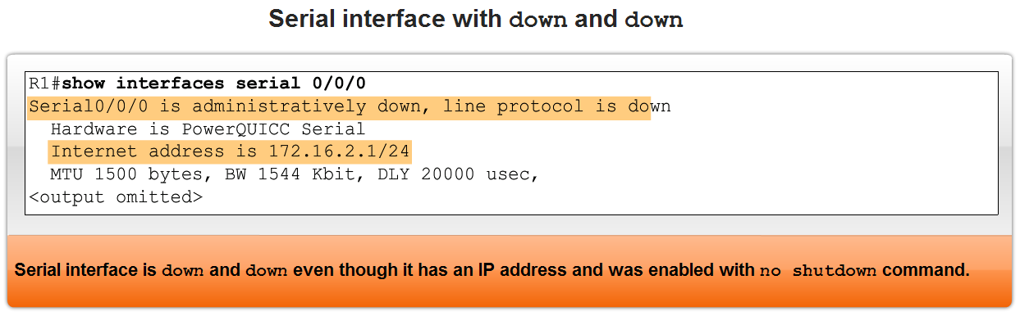
Interfaces
Configuring a Serial interface
  Enter interface configuration mode
  Enter in the ip address and subnet mask
  Enter in the no shutdown command
Example:
  R1(config)#interface serial 0/0
  R1(config-if)#ip address 172.16.2.1 255.255.255.0
  R1(config-if)#no shutdown

Slide 9
Interfaces
Examining Router Interfaces
  Physically connecting a WAN Interface.
  A WAN Physical Layer connection has sides:
    Data Circuit-terminating Equipment (DCE) – This is the service provider. CSU/DSU is a DCE device.
    Data Terminal Equipment (DTE) – Typically the router is the DTE device.

Slide 10
Interfaces
Configuring serial links in a lab environment
  One side of a serial connection must be considered a DCE.
  This requires placing a clocking signal – use the clock rate command.
  Example:
    R1(config)#interface serial 0/0
    R1(config-if)#clockrate 64000
  Serial Interfaces require a clock signal to control the timing of the communcations.

Slide 11
Routing Table and CDP Protocol
Purpose of the debug ip routing command
  Allows you to view changes that the router performs when adding or removing routes.
  Example:
    R2#debug ip routing
    IP routing debugging is on

Slide 12
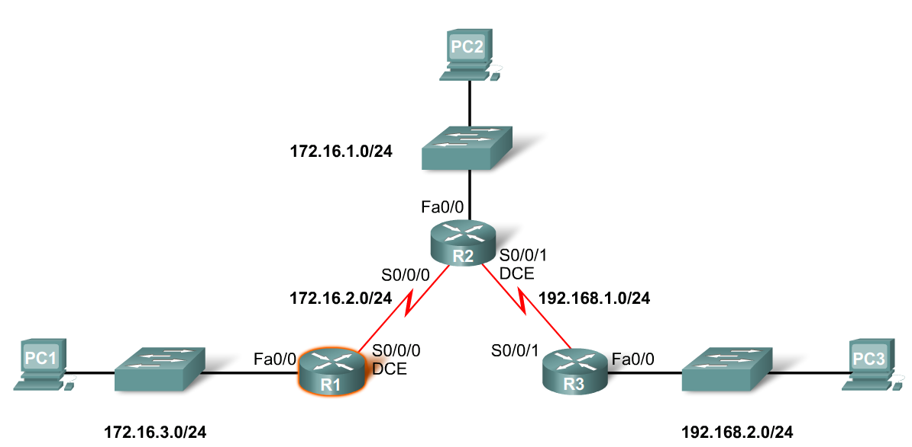
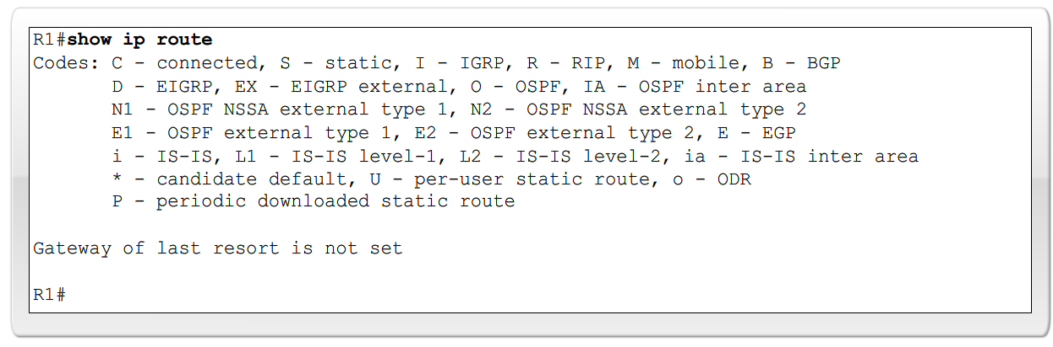
Routing Table and CDP Protocol
To configure an Ethernet interface
  Example:
    R2(config)#interface fastethernet 0/0
    R2(config-if)#ip address 172.16.1.1 255.255.255.0
    R2(config-if)#no shutdown

Slide 13
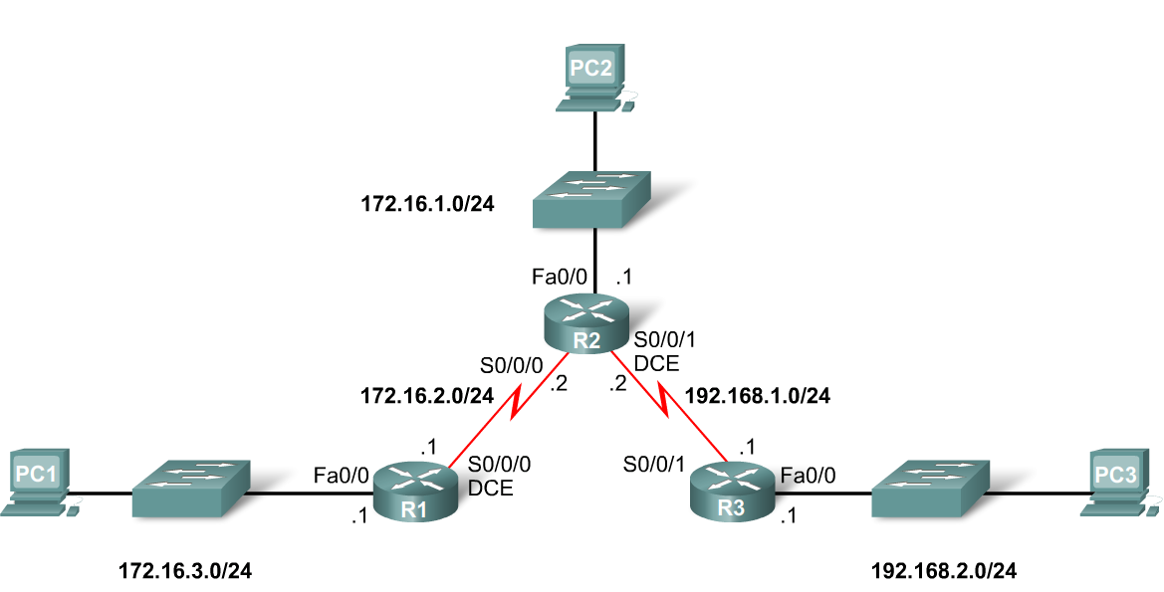
Routing Table and CDP Protocol
When a router only has its interfaces configured & no other routing protocols are configured then:
  The routing table contains only the directly connected networks
  Only devices on the directly connected networks are reachable

Slide 14
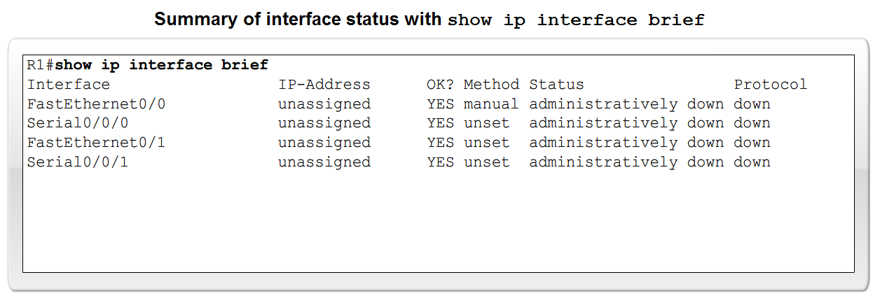
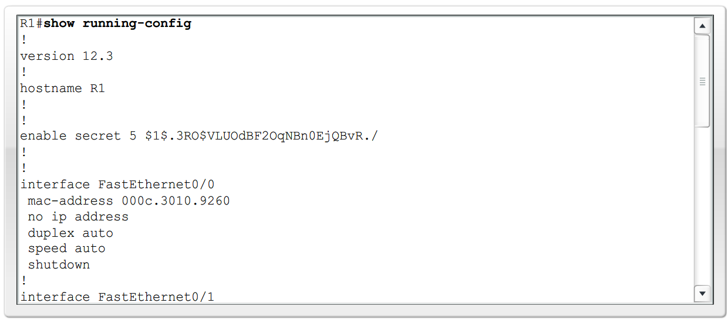
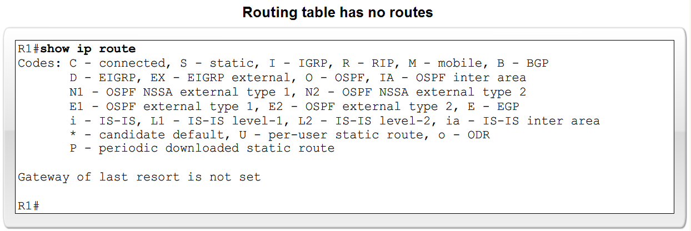
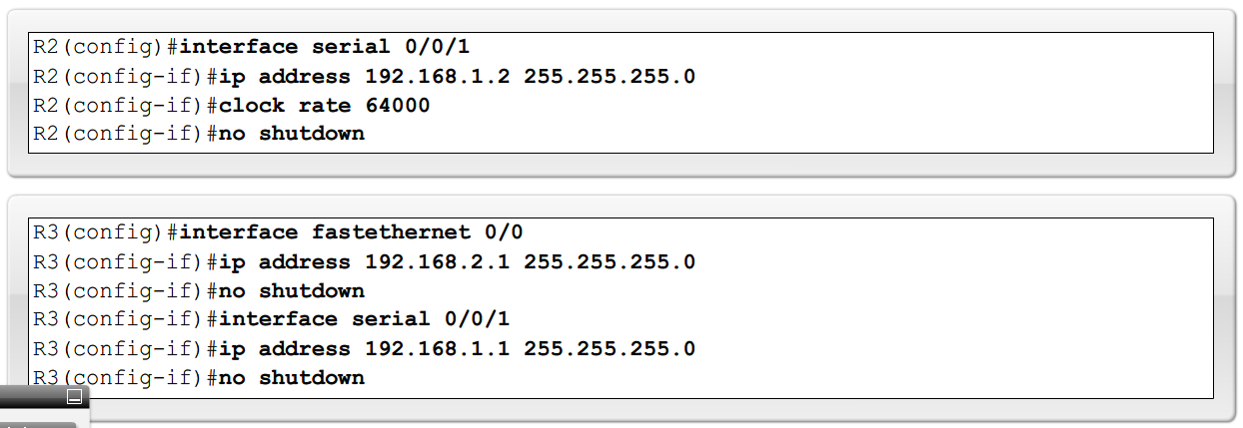
Routing Table and CDP Protocol

Slide 15
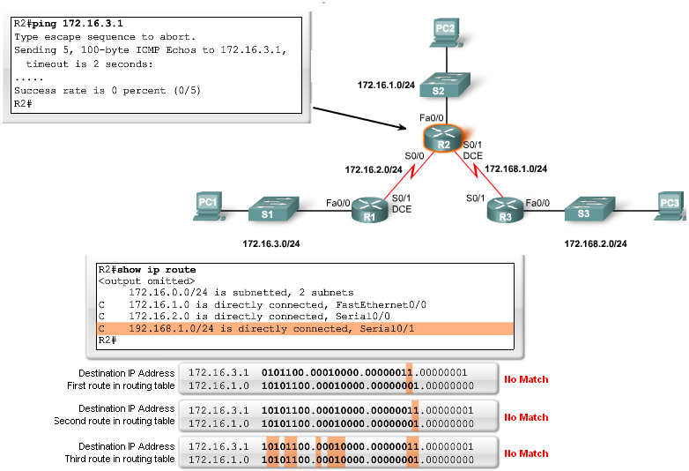
Routing Table and CDP Protocol
Checking each route in turn
  The ping command is used to check end to end connectivity

Slide 16
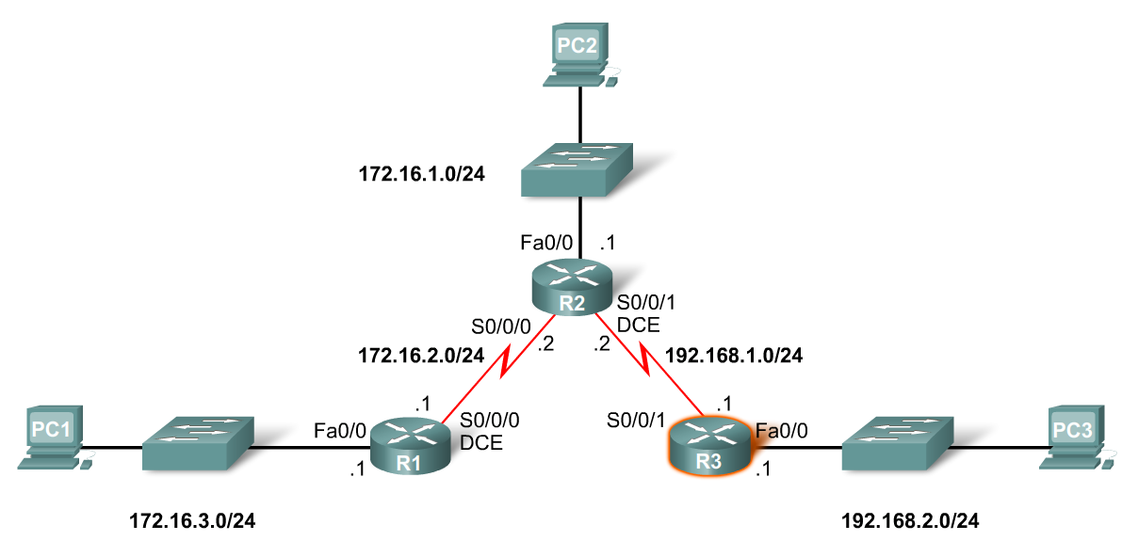
Routing Table and CDP Protocol
Purpose of CDP
  A layer 2 cisco proprietary tool used to gather information about other directly connected Cisco devices.
Concept of neighbors
  2 types of neighbors:
    Layer 3 neighbors
    Layer 2 neighbors

Slide 17
Routing Table and CDP Protocol
CDP show commands
  Show cdp neighbors command
    Displays the following information:
      Neighbor device ID
      Local interface
      Holdtime value, in seconds
      Neighbor device capability code
      Neighbor hardware platform
      Neighbor remote port ID
  Show cdp neighbors detail command
    Useful in determining if an IP address configuration error

Slide 18
Routing Table and CDP Protocol
Disabling CDP
  To disable CDP globally use the following command
    Router(config)#no cdp run

Slide 19
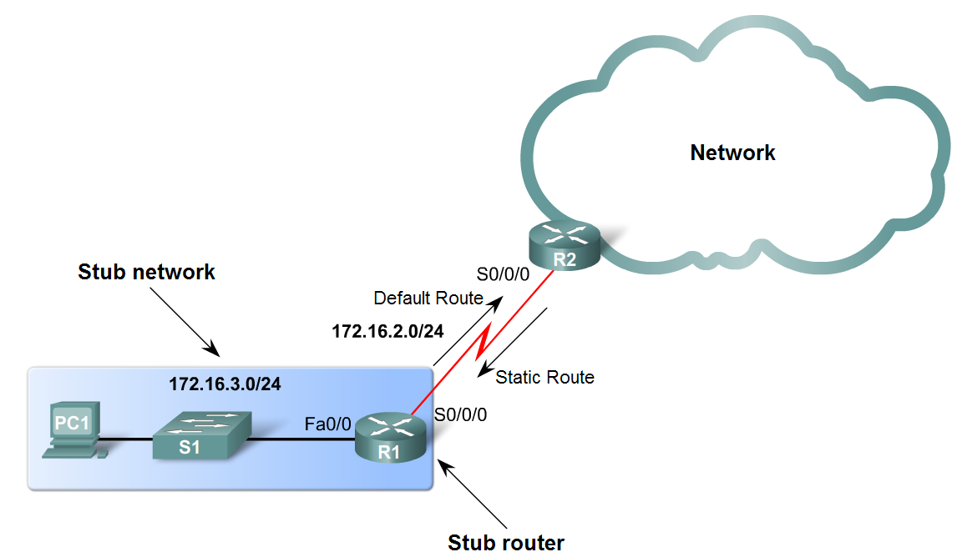
Static Routes with Exit Interfaces
Purpose of a static route
  A manually configured route used when routing from a network to a stub network

Slide 20
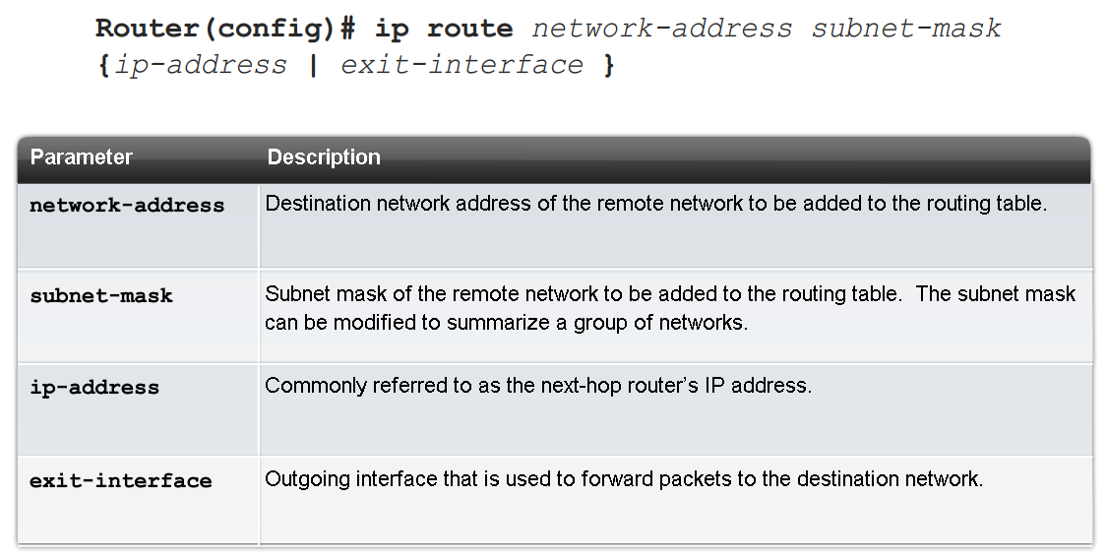
Static Routes with Exit Interfaces
IP route command
  To configure a static route use the following command: ip route
  Example:
    Router(config)# ip route network-address subnet-mask {ip-address | exit-interface }

Slide 21

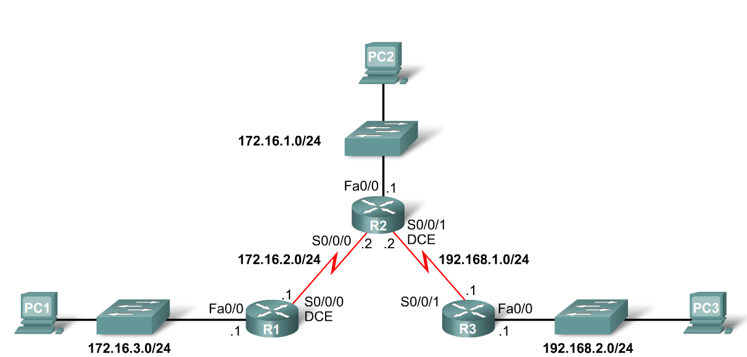
Static Routes with Exit Interfaces
Dissecting static route syntax
  ip route - Static route command
  172.16.1.0 – Destination network address
  255.255.255.0 - Subnet mask of destination network
  172.16.2.2 - Serial 0/0/0 interface IP address on R2, which is the "next-hop" to this network

Slide 22
Static Routes with Exit Interfaces
Configuring routes to 2 or more remote networks
  Use the following commands for R1
    R1(config)#ip route 192.168.1.0 255.255.255.0 172.16.2.2
    R1(config)#ip route 192.168.2.0 255.255.255.0 172.16.2.2

Slide 23
Static Routes with Exit Interfaces
Zinin’s 3 routing principles
  Principle 1: “Every router makes its decision alone, based on the information it has in its own routing table.”
  Principle 2: “The fact that one router has certain information in its routing table does not mean that other routers have the same information.”
  Principle 3: “Routing information about a path from one network to another does not provide routing information about the reverse, or return path.”

Slide 24
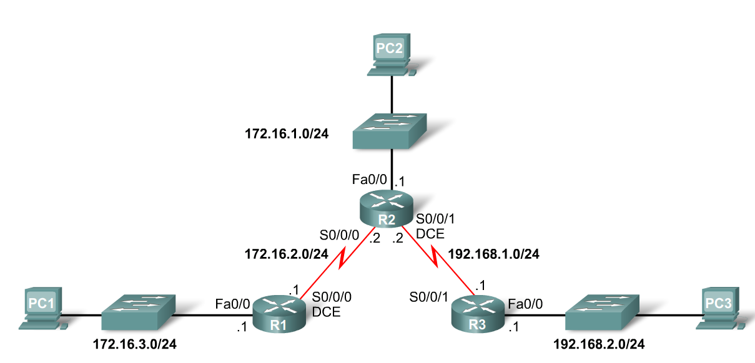
Static Routes with Exit Interfaces
Using Zinin’s 3 routing principles, how would you answer the following?
  Would packets from PC1 reach their destination?
    Yes, packets destined for 172.16.1.0/24 and 192.168.1.0/24 networks would reach their destination.
  Does this mean that any packets from these networks destined for 172.16.3.0/24 network will reach their destination?
    No, because neither R2 nor R3 router has a route to the 172.16.3.0/24 network.

Slide 25

Static Routes with Exit Interfaces
Resolving to an Exit Interface
  Recursive route lookup - Occurs when the router has to perform multiple lookups in the routing table before forwarding a packet. A static route that forwards all packets to the next-hop IP address goes through the following process (reclusive route lookup).
    The router first must match static route’s destination IP address with the Next hop address.
    The next hop address is then matched to an exit interface.

Slide 26
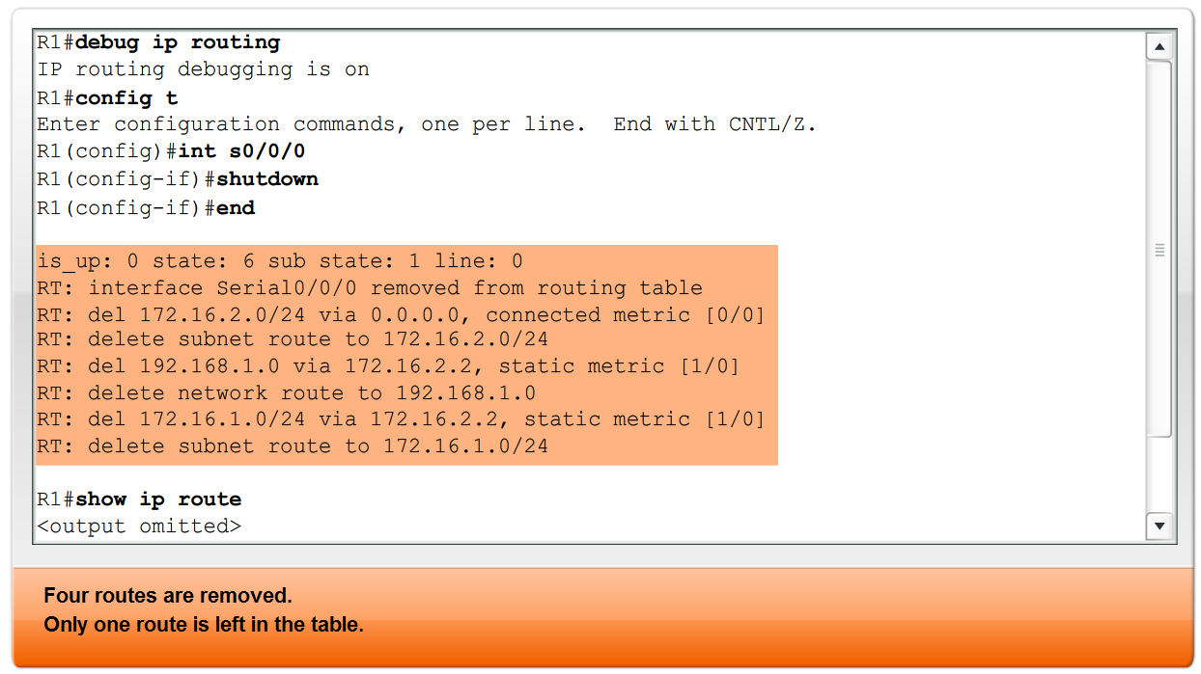
Static Routes with Exit Interfaces
Configuring a Static route with an Exit Interface
  Static routes configured with an exit interface are more efficient because the routing
  The routing table can resolve the exit interface in a single search instead of 2 searches
  Example of syntax require to configure a static route with an exit interface

Slide 27
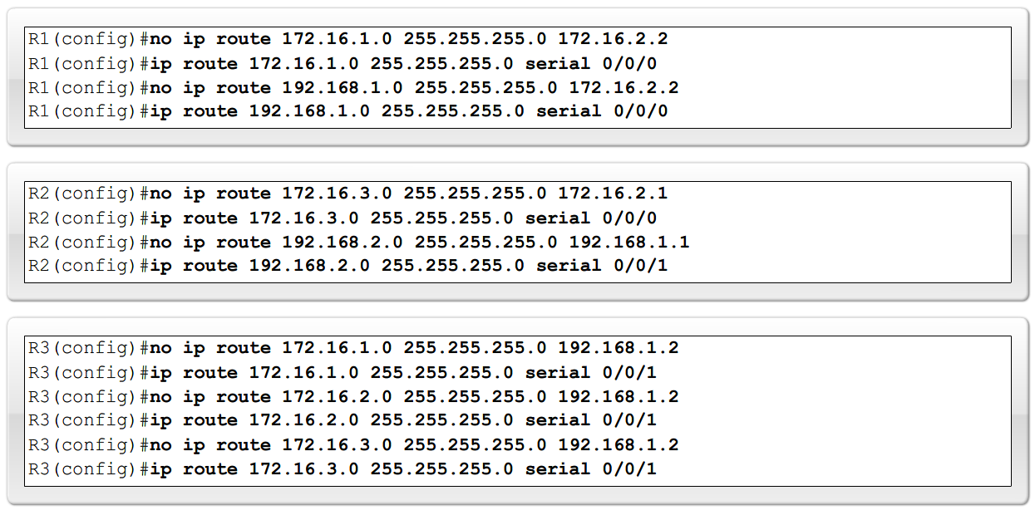
Static Routes with Exit Interfaces
Modifying Static routes
  Existing static routes cannot be modified. The old static route must be deleted by placing no in front of the ip route
  Example:
    no ip route 192.168.2.0 255.255.255.0 172.16.2.2
  A new static route must be rewritten in the configuration

Slide 28
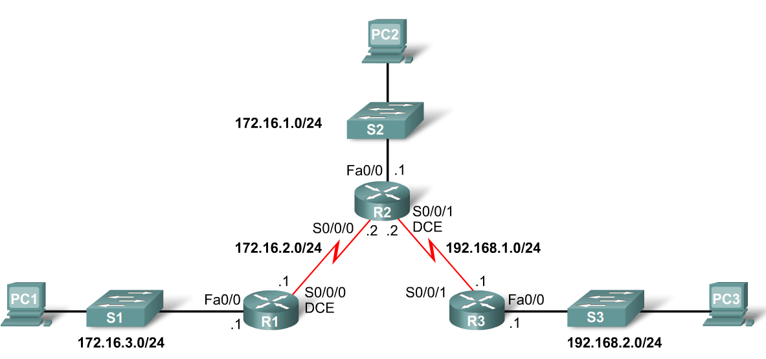
Static Routes with Exit Interfaces
Verifying the Static Route Configuration
  Use the following commands
    Step 1 show running-config
    Step 2 verify static route has been entered correctly
    Step 3 show ip route
    Step 4 verify route was configured in routing table
    Step 5 issue ping command to verify packets can reach destination and that Return path is working

Slide 29
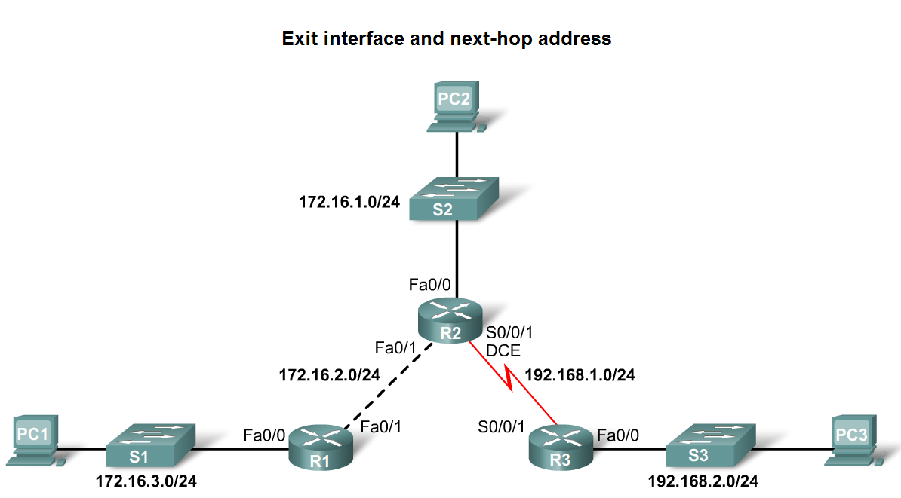
Static Routes with Exit Interfaces
Ethernet interfaces and ARP
  If a static route is configured on an Ethernet link and packet is sent to the next-hop router then…
    The destination MAC address will be the address of the next hop’s Ethernet interface
    This is found by the router consulting the ARP table
    If an entry isn’t found then an ARP request will be sent out

Slide 30
Summary and Default Route
Summarizing routes reduces the size of the routing table.
Route summarization is the process of combining a number of static routes into a single static route.

Slide 31
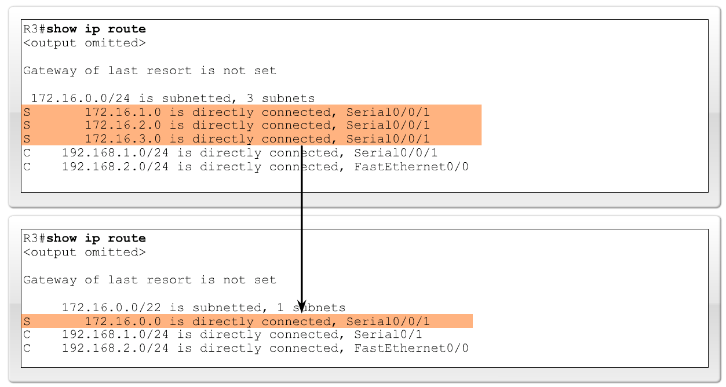
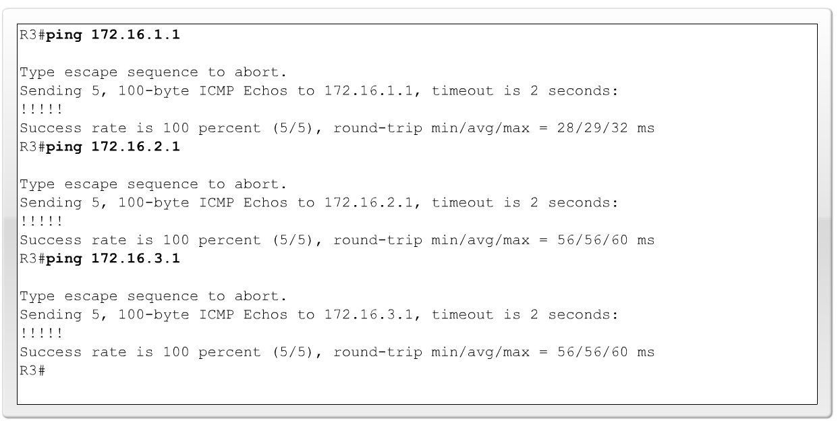
Summary and Default Route
Configuring a summary route
  Step 1: Delete the current static route
  Step 2: Configure the summary static route
  Step 3: Verify the new static route

Slide 32
Summary and Default Route
Default Static Route
  This is a route that will match all packets. Stub routers that have a number of static routes all exiting the same interface are good candidates for a default route.
    Like route summarization this will help reduce the size of the routing table.
Configuring a default static route
  Similar to configuring a static route. Except that destination IP address and subnet mask are all zeros.
  Example:
    Router(config)#ip route 0.0.0.0 0.0.0.0 [exit-interface | ip-address ].

Slide 33
Summary and Default Route
Static routes and subnet masks
  The routing table lookup process will use the most specific match when comparing destination IP address and subnet mask
Default static routes and subnet masks
  Since the subnet mask used on a default static route is 0.0.0.0 all packets will match

Slide 34
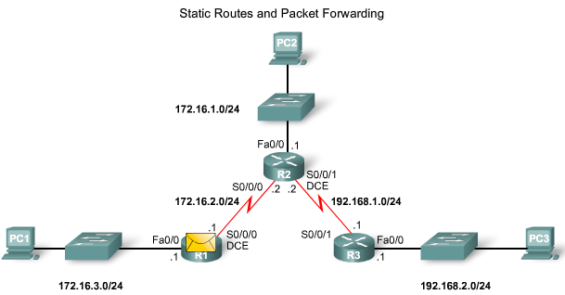
Static Routes and Packet Forwarding
Packet forwarding with static routes (recall Zinin’s 3 routing principles)
Router 1
  Packet arrives on R1’s Fastethernet 0/0 interface
  R1 does not have a route to the destination network, 192.168.2.0/24
  R1 uses the default static route

Slide 35
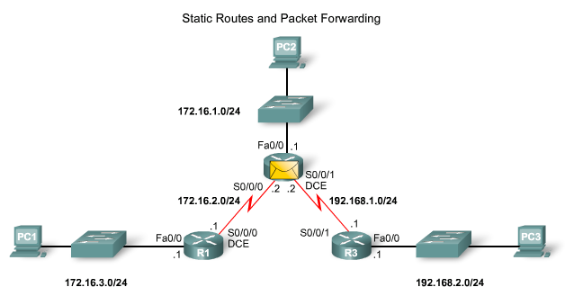
Static Routes and Packet Forwarding
Packet forwarding with static routes (recall Zinin’s 3 routing principles)
Router 2
  The packet arrives on the Serial 0/0/0 interface on R2
  R2 has a static route to 192.168.2.0/24 out Serial0/0/1

Slide 36
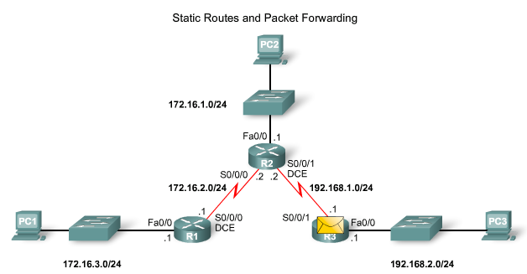
Static Routes and Packet Forwarding
Packet forwarding with static routes. (recall Zinin’s 3 routing principles)
Router 3
  The packet arrives on the Serial0/0/1 interface on R3
  R3 has a connected route to 192.168.2.0/24 out Fastethernet 0/1

Slide 37
Static Routes and Packet Forwarding
Troubleshooting a Missing Route
Tools that can be used to isolate routing problems include:
  Ping - tests end to end connectivity
  Traceroute - used to discover all of the hops (routers) along the path between 2 points
  Show IP route - used to display routing table & ascertain forwarding process
  Show ip interface brief - used to show status of router interfaces
  Show cdp neighbors detail - used to gather configuration information about directly connected neighbors

Slide 38
Static Routes and Packet Forwarding
Solving a Missing Route
Finding a missing or mis-configured route requires methodically using the correct tools
  Start with PING - if ping fails then use traceroute to determine where packets are failing to arrive
Issue: show ip route to examine routing table
  If there is a problem with a mis-configured static route remove the static route then reconfigure the new static route

Slide 39
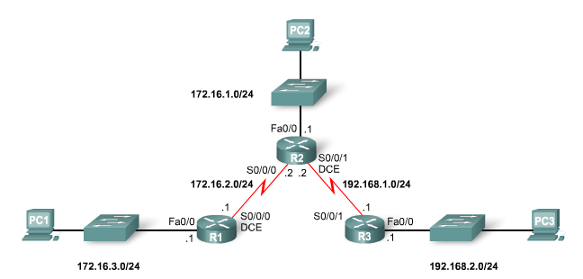
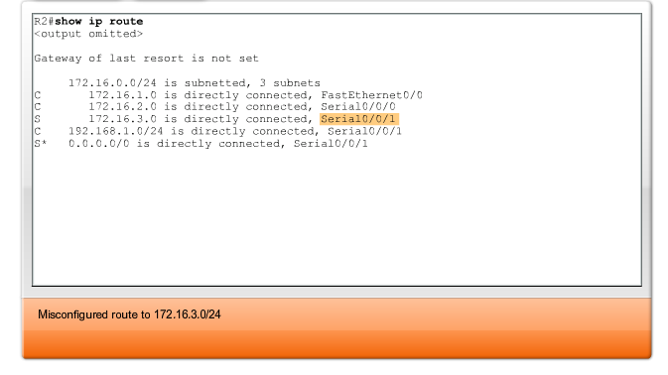
Static Routes and Packet Forwarding
Solving a Missing Route

Slide 40
Summary
Routers
  Operate at layer 3.
  Functions include best path selection & forwarding packets.
Connecting Networks
  WANs
    Serial cables are connected to router serial ports.
    In the lab environment clock rates must be configured for DCE.
  LANs
    Straight through cables or cross over cables are used to connect to fastethernet port. (The type of cable used depends on what devices are being connected.)
Cisco Discovery Protocol
  A layer 2 proprietary protocol.
  Used to discover information about directly connected Cisco devices.

Slide 41
Summary
Static Routes
  This is a manually configured path that specifies how the router will get to a certain point using a certain path.
Summary static routes
  This is several static routes that have been condensed into a single static route.
Default route
  It is the route packets use if there is no other possible match for their destination in the routing table.
Forwarding of packets when static route is used
  Zinin’s 3 routing principles describe how packets are forwarded
Troubleshooting static routes may require some of the following commands:
  Ping
  Traceroute
  Show IP route
  Show ip interface brief
  Show cdp neighbors detail

